Slide 1
OOP Based Application
Shana Charlery

Slide 2
The brief
The aim is to create an OOP based application using CRUD method. Here the incorporation of tools methods and technologies was implemented.
Notes:
The application must be able to control and alter data via at two tables via the functionality of CRUD.

Slide 3
Solution
I chose to make a Christian website through Flask. The purpose of the website was for customers to be able to add information such as a motivation quote.
Notes:
-Talk about CR & UD in CRUD
-They would be redirected to the home page, from there they would be able to see and read their quote.

Slide 4
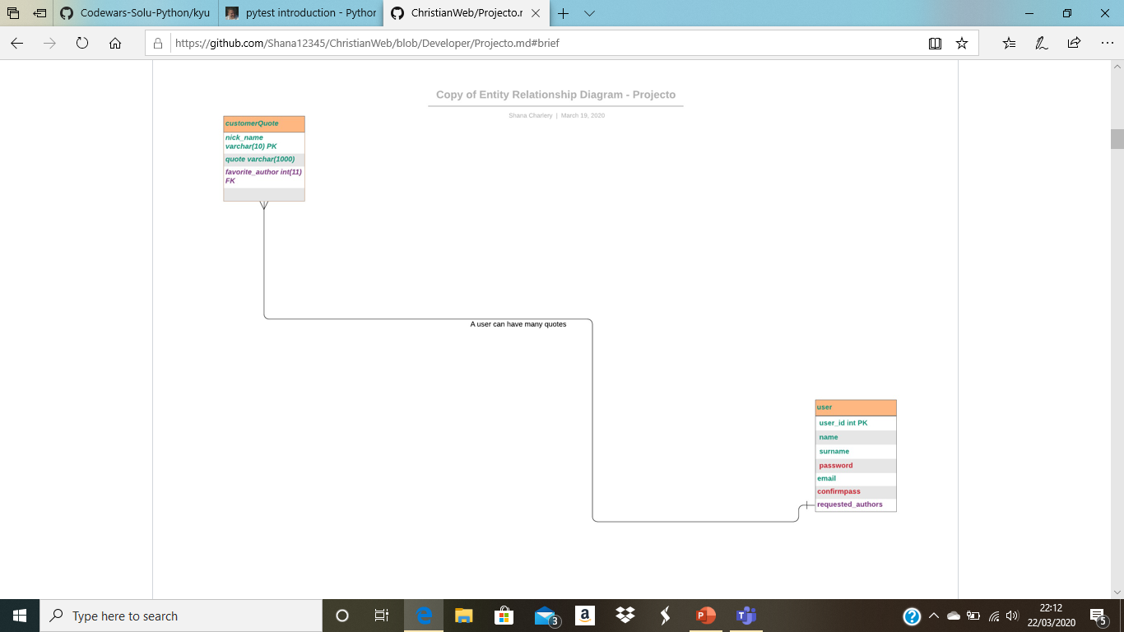
ERD
Notes:
Original ERD – what the colours mean

Slide 5
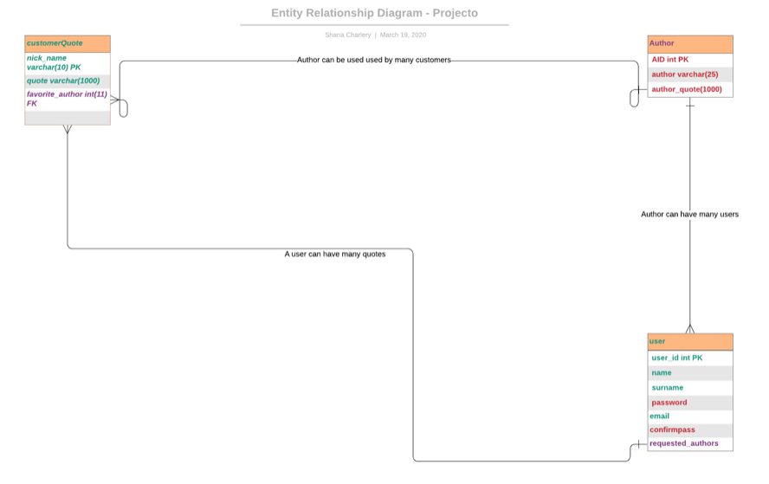
ERD Final
Notes:
- The origin plan for the ERD consisted of less tables and entities than were produced in the final application.
- Explain the relationships between tables.
- Why you choice to add extra tables.

Slide 6
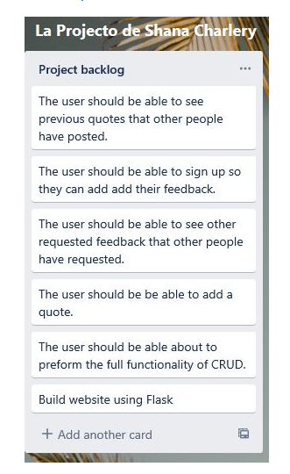
Product Backlog
Notes:
Here, is where all the requirements of the project are listed,
Why it isn't coloured coded to show the list of priorities? - you preferred to colour code the actually ERD diagram as it was a better way of prioritising.

Slide 7
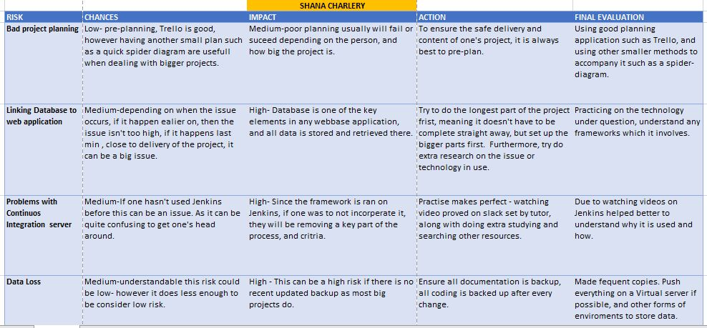
Risk Assessment
Notes:
Here, is analysing potential actions that can have a negative impact towards individuals, or the surrounding.

Slide 8
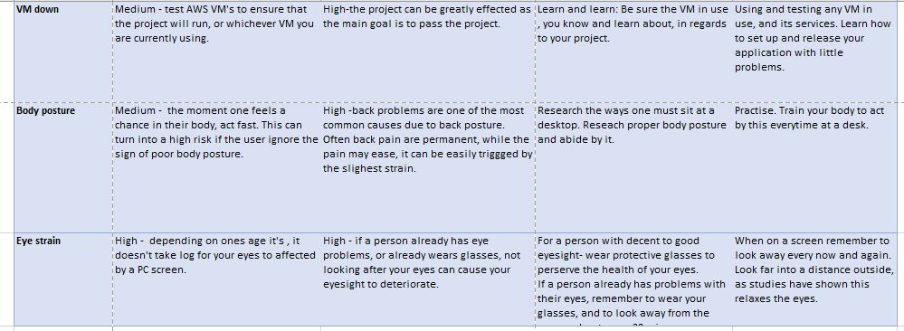
Risk Assessment
Notes:
More risks

Slide 9
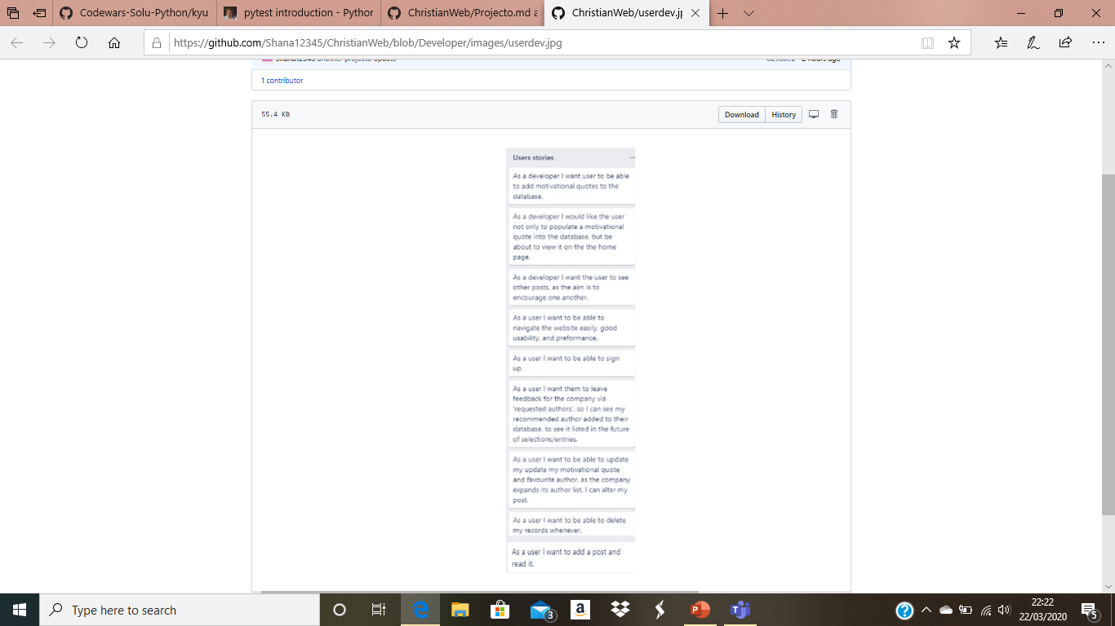
User & Developer
Notes:
Trello was used, there was listed all the use-cases for the product in the terms of a ‘user’ and ‘developer’.

Slide 10
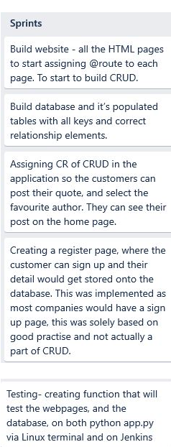
Sprints
Notes:
- Each entry represents a sprint. Each sprint was roughly aimed to be 4 days, however each needed to be met.
- Explain the sprints

Slide 11
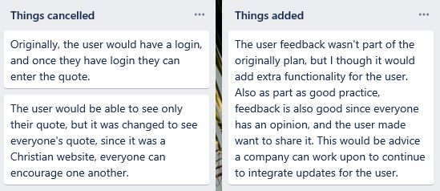
Things added & Cancelled
Notes:
-Explain things cancelled(include ‘search bar’ – why? Time limitations, the change was to long to be implemented to replace another idea.
-Things added – why? Extra functionality to the project , good practise, - because everybody has an opinion or recommendation.

Slide 12
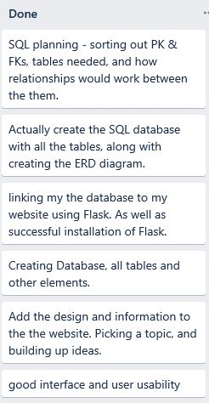
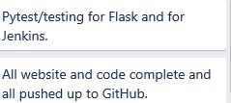
Trello to completion
The project is now in the completion stage, where all are moved to the 'Done' as all tasks was complete along with other optional features and functionality.
Notes:
So again other features (un-needed) were not implemented such as the search function because of time limitations.

Slide 13
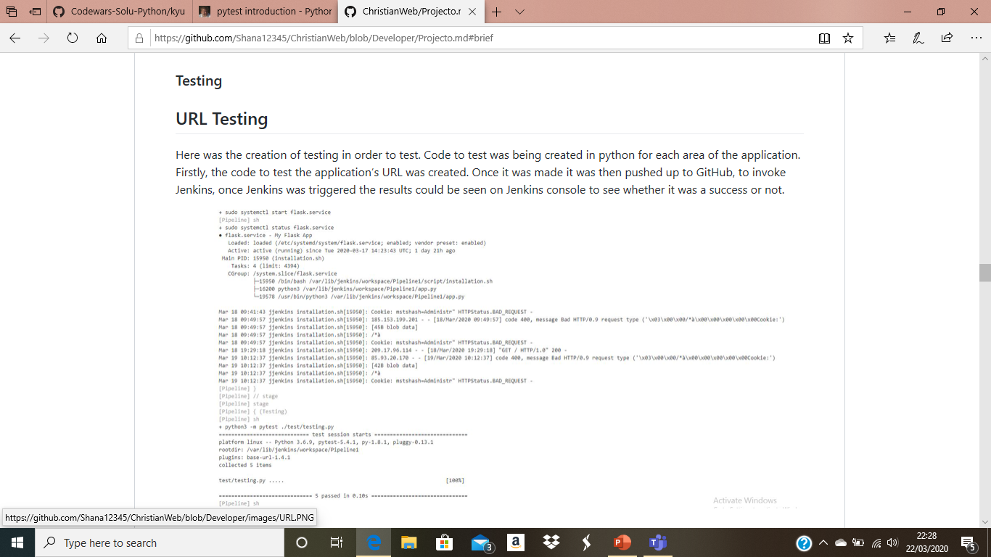
Jenkins URL Testing
Notes:
Testing URLs – you ran in on VS; testing it on Jenkins - pushed up to Jenkins; all pages passed at5 100%

Slide 14
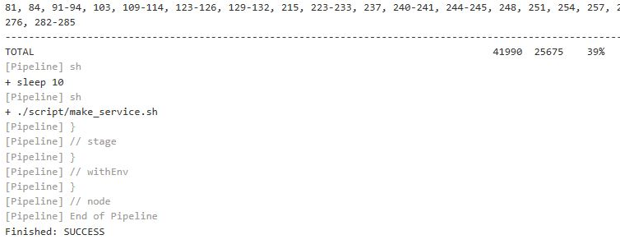
Database Testing and full coverage report Test coverage for the coverage report passed at 39%
Notes:
-Test coverage for the coverage report passed at 39%.

Slide 15
DEPLOYMENT
The automated build, test and deployment process was done by Jenkins, via a webhook to GitHub which was triggered with every push event.
Notes:
This website can be deployed both locally as well as externally by a virtual machine.

Slide 16
Technologies Used
GCP Database Engine - Database
Python - Logic
Jenkins - CI Server
Git - VCS
Trello - Project Tracking

Slide 17
Front End Visual Representation of my Solution
Notes:
Moving onto ….Front end visual

Slide 18
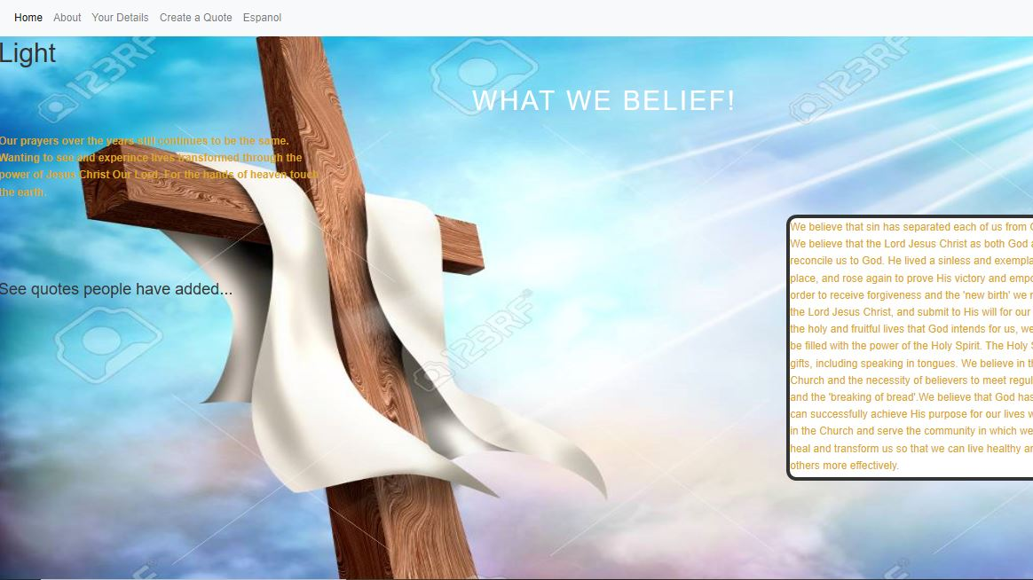
HOMEPAGE
Notes:
Explain shortly what’s on the page

Slide 19
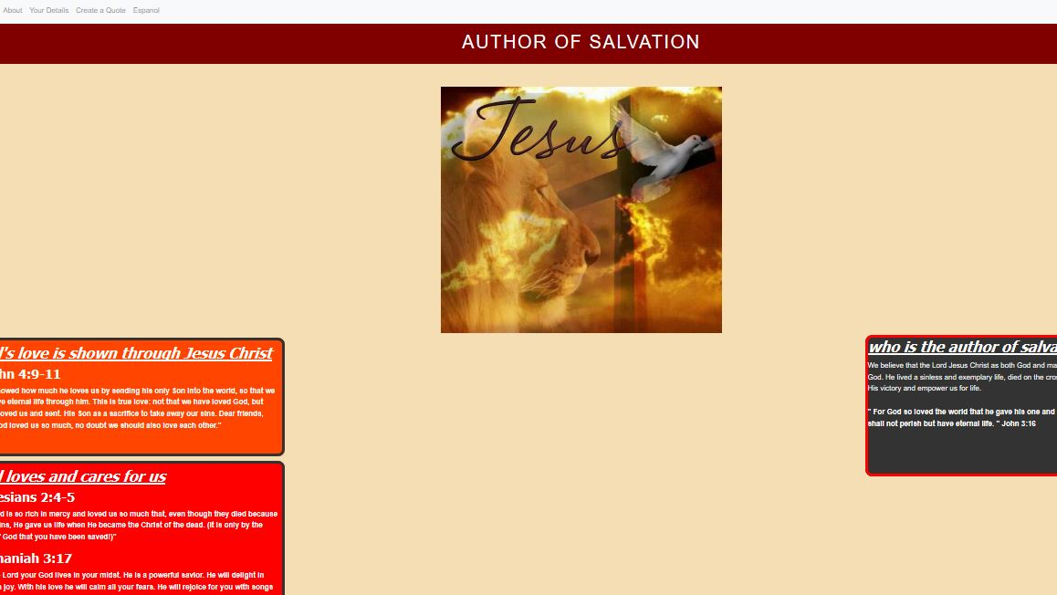
ABOUT
Notes:
Explain shortly what’s on the page

Slide 20
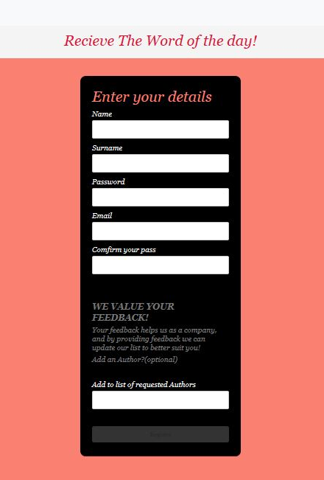
REGISTER
Notes:
Explain shortly what’s on the page

Slide 21
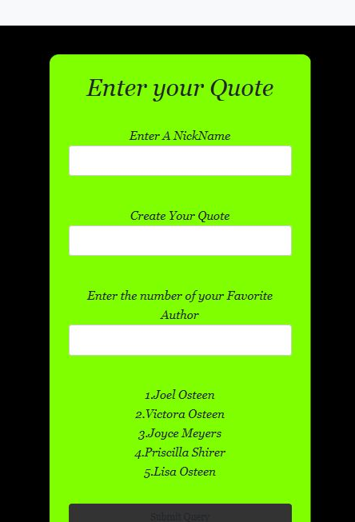
CREATE A QUOTE
Notes:
Explain shortly what’s on the page

Slide 22
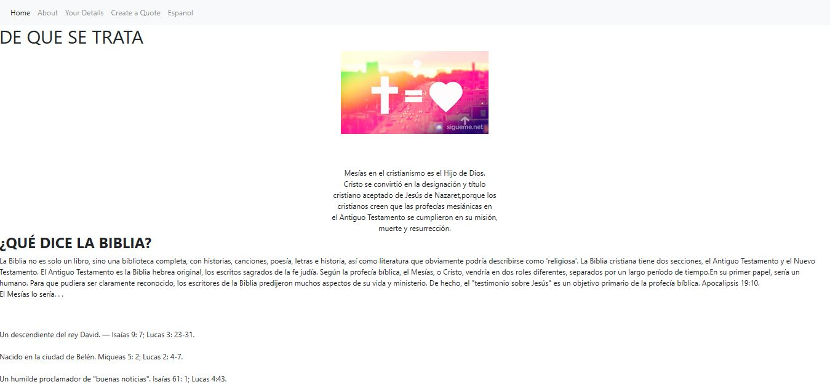
español
Notes:
Explain shortly what’s on the page

Slide 23
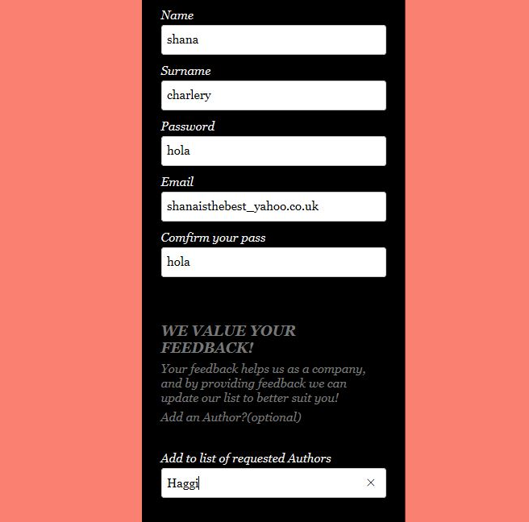
Registering and requesting a future author

Slide 24
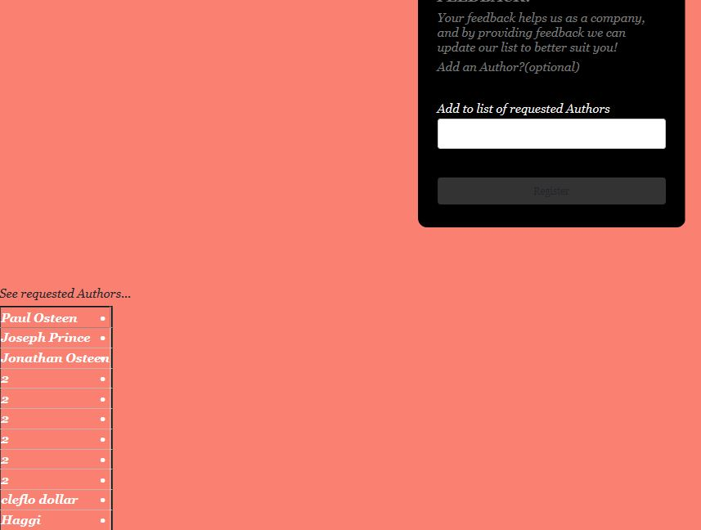
Requested author added

Slide 25
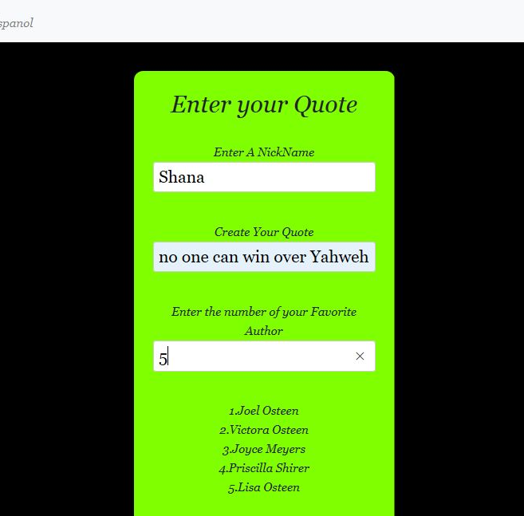
Entering a quote

Slide 26
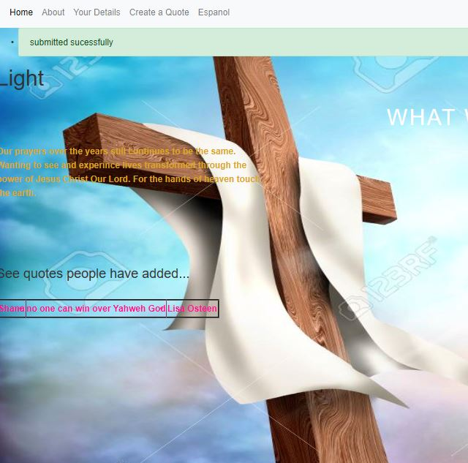
Quote Added

Slide 27
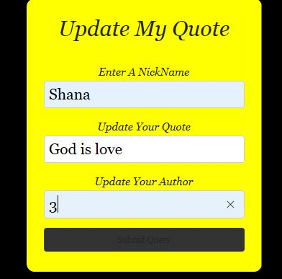
Updating my quote

Slide 28
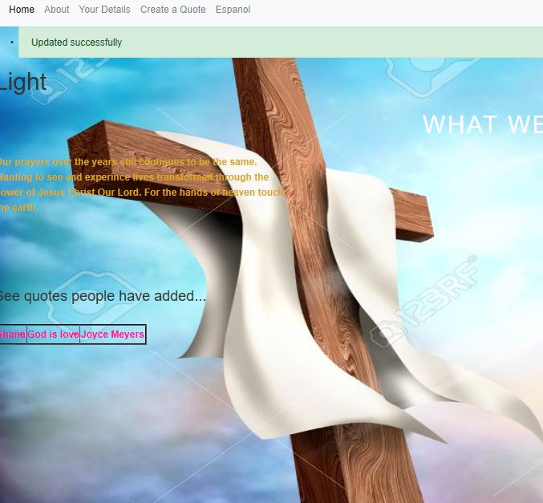
Quote Updated

Slide 29
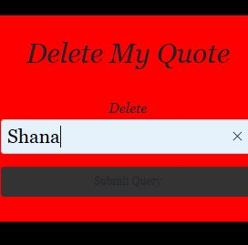
Delete a quote

Slide 30
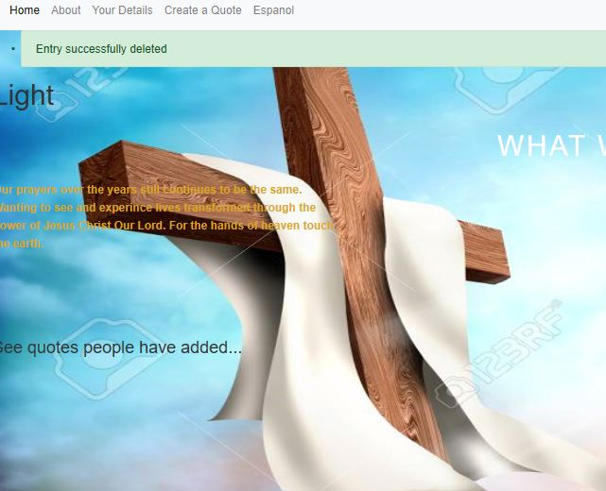
Quote Delete

Slide 31
Improvements for the Future
The improvement that needed to be made would be adding the extra functionality.
Notes:
So the 'things cancelled' on the kanban board. In addition, adding a search function to enhance usability.

Slide 32
Authors
Shana Charlery
Acknowledgements
QA consulting and our fantastic instructors
The rest of our wonderful cohort on the programme

Slide 33
The end
Thank you for listening ☺

